Slide 1
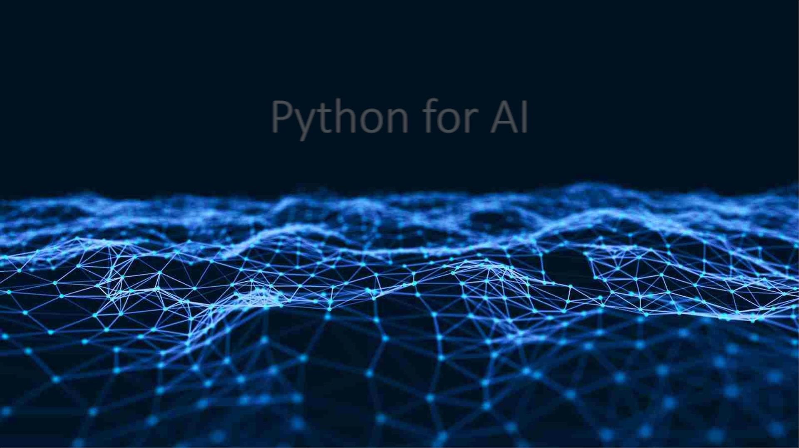
Python for AI
Name : T Bala Sai Vamsi
Reg.no : 20BCE7407

Slide 2
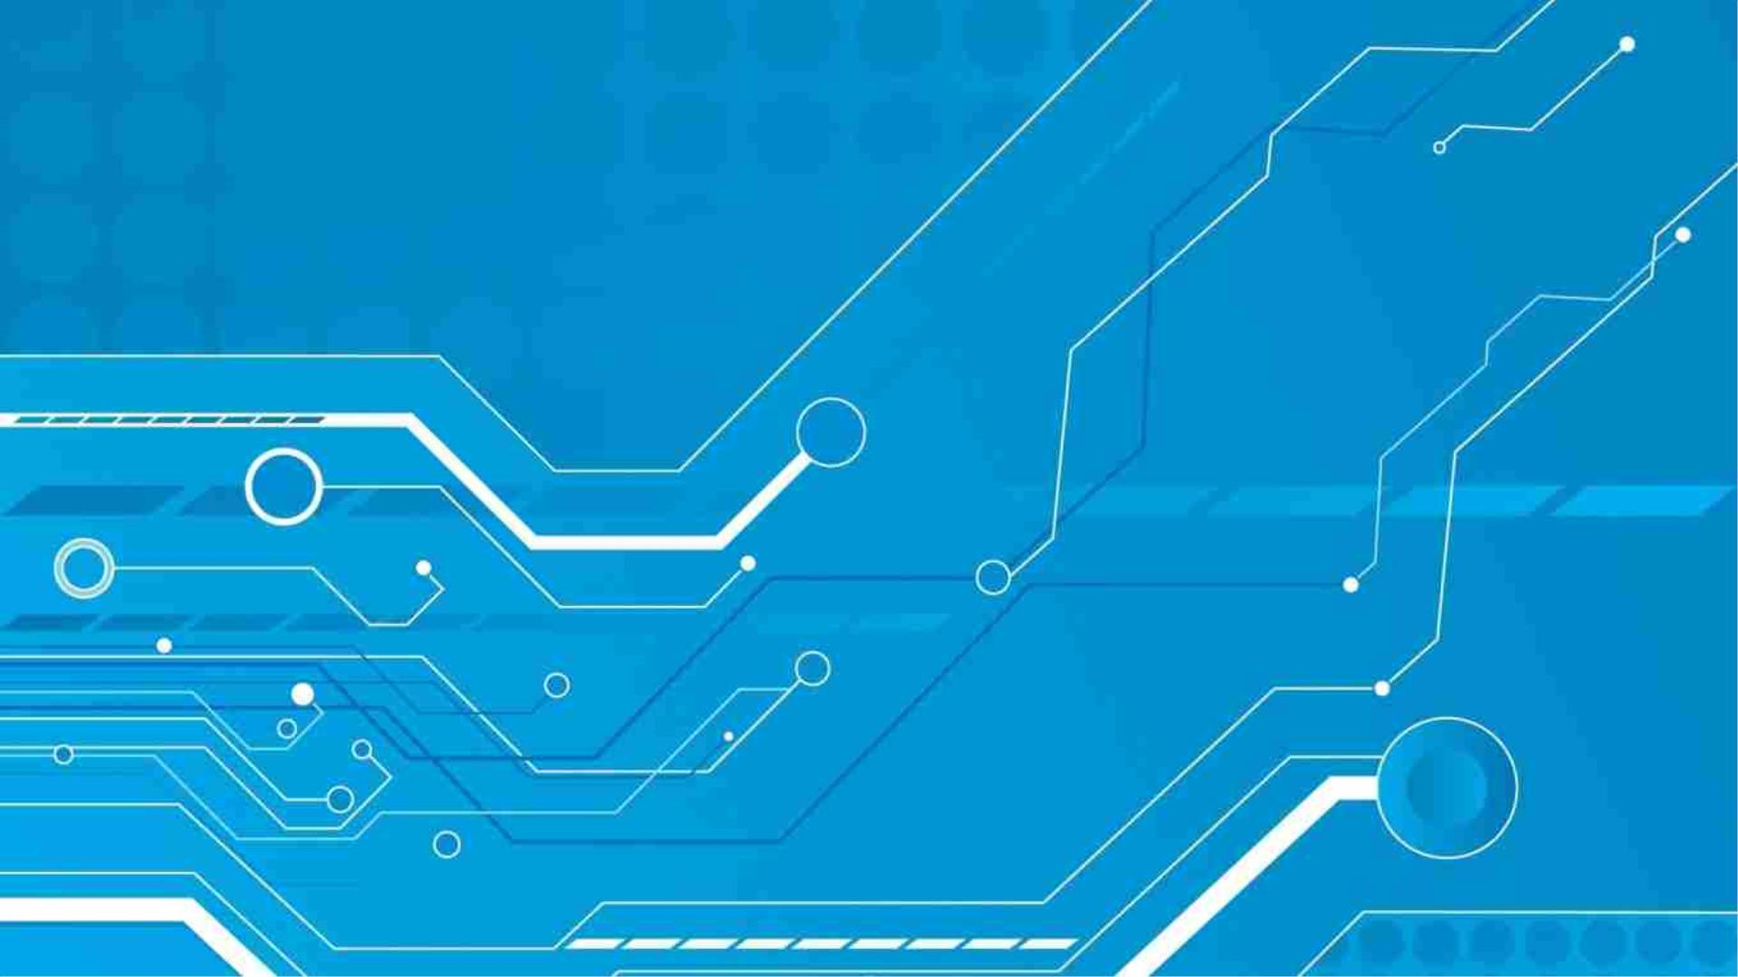
Technologies Used :
• Numpy
• Tensor flow
• Open CV

Slide 3
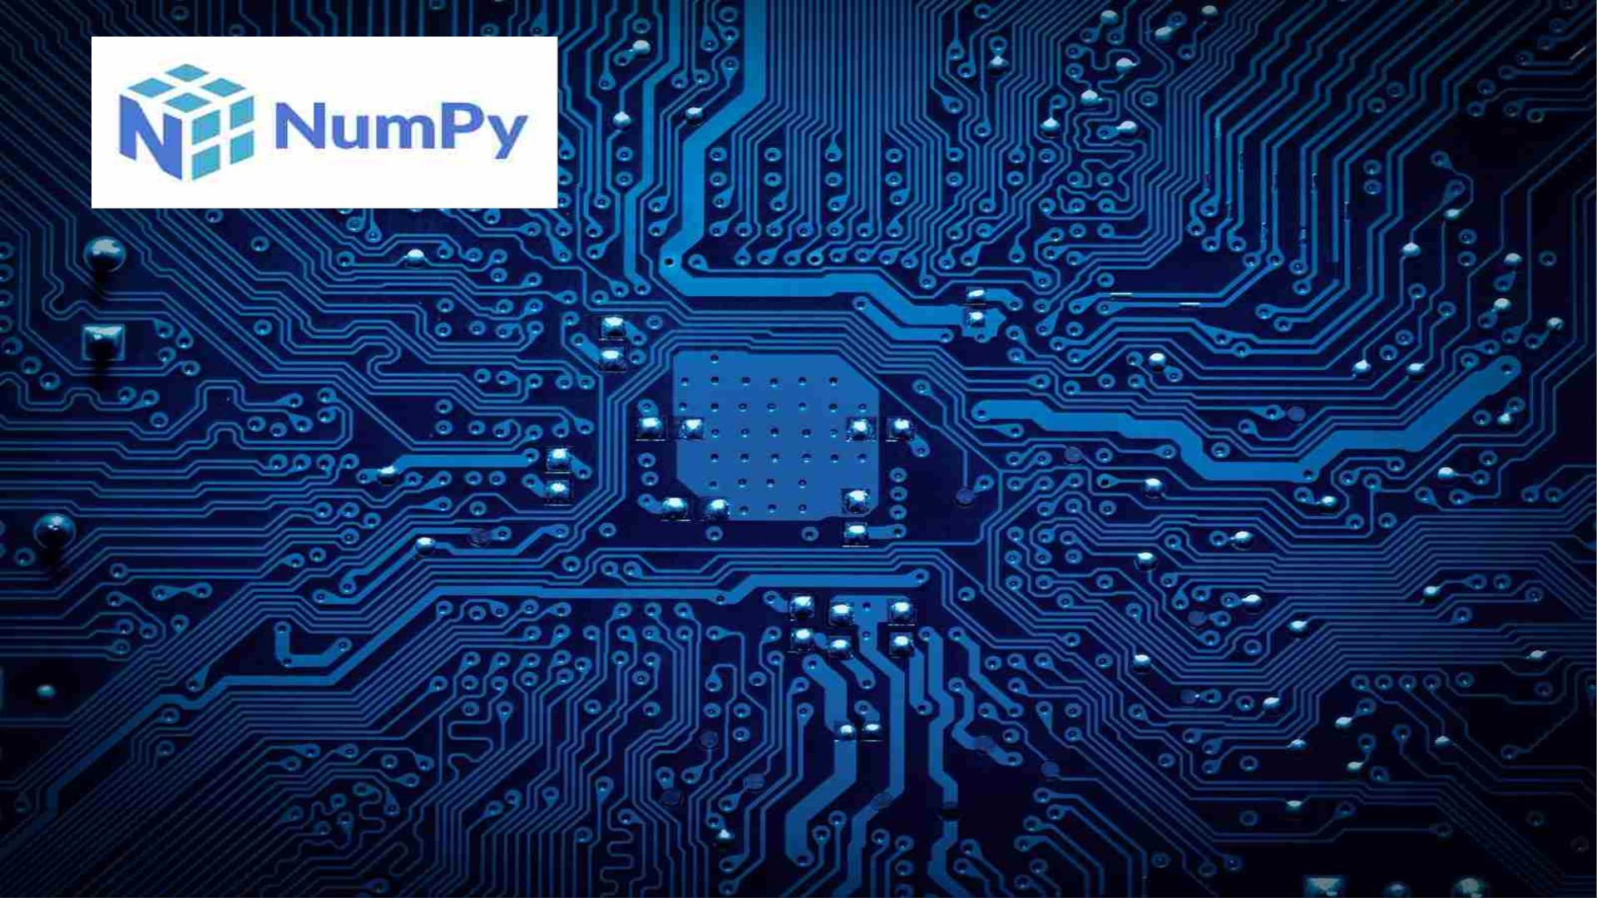
NumPy is a general-purpose array-processing package. It provides a high
-performance multidimensional array object, and tools for working with
these arrays. It is the fundamental package for scientific computing with
Python. It is open-source software. It contains various features including
these important ones:
A powerful N-dimensional array object
Sophisticated (broadcasting) functions
Tools for integrating C/C++ and Fortran code
Useful linear algebra, Fourier transform, and random number
capabilities

Slide 4
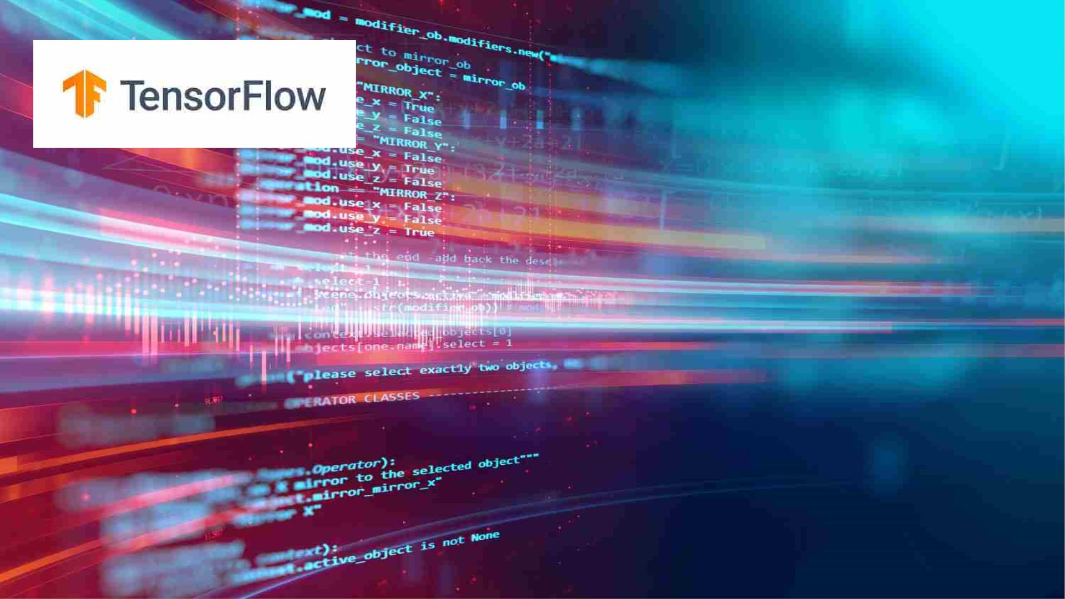
• TensorFlow is a popular framework of machine learning and deep learning. It is a free and open-source
library developed by Google Brain Team. It is entirely based on Python programming language and use for
numerical computation and data flow, which makes machine learning faster and easier.
• TensorFlow can train and run the deep neural networks for image recognition, handwritten digit
classification, recurrent neural network, word embedding, natural language processing, video detection,
and many more. TensorFlow is run on multiple CPUs or GPUs and also mobile operating systems.
• The word TensorFlow is made by two words, i.e., Tensor and Flow
• Tensor is a multidimensional array
• Flow is used to define the flow of data in operation.

Slide 5
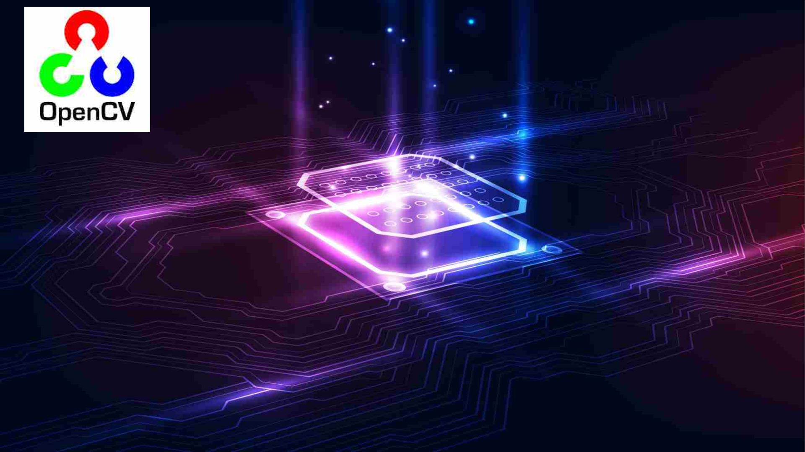
• OpenCV is the huge open-source library for the computer
vision, machine learning, and image processing and now it
plays a major role in real-time operation which is very
important in today’s systems. By using it, one can process
images and videos to identify objects, faces, or even
handwriting of a human. When it integrated with various
libraries, such as NumPy, python is capable of processing the
OpenCV array structure for analysis. To Identify image pattern
and its various features we use vector space and perform
mathematical operations on these features.

